Slide 1
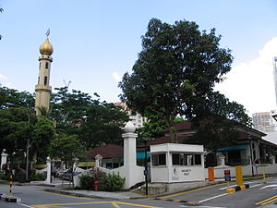
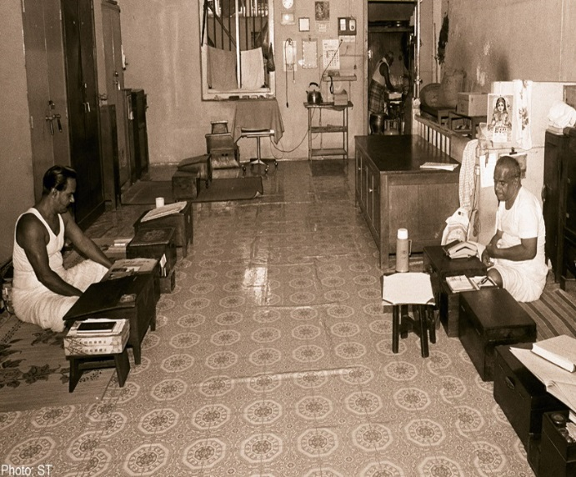
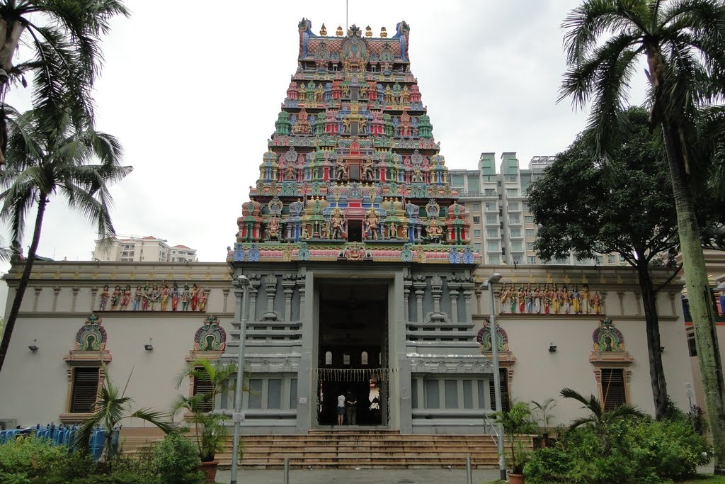
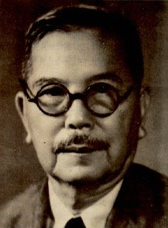
NATIONAL UNIVERSITY OF SINGAPORE
DEPARTMENT OF HISTORY
Singapore’s Business History
Mercantile Communities & Early Industries in the Colonial Port
Lecture III (Part I)
Masjid Omar Kampong Melaka
A/P Medha Kudaisya
Tan Kah Kee
Chettiar Temple, Tank Road

Slide 2
Lecture Outline
Mercantile Communities: Role in the Making of the World Economy
Trading Communities in Colonial Singapore
  Arab Traders
    Arrival
    Economic Activities and Niches
    Golden Age of Hadramis
    Changing Fortunes : Inability to make the transition from trade to creation of industrial conglomerates (Reasons for decline in economic position)
  Chettiar Merchants
    Arrival
    Money-lending and other Economic Niches
    The Great Depression of the 1930s and Declining fortunes of the Chettiars
Chinese Traders & Early Industries

Slide 3
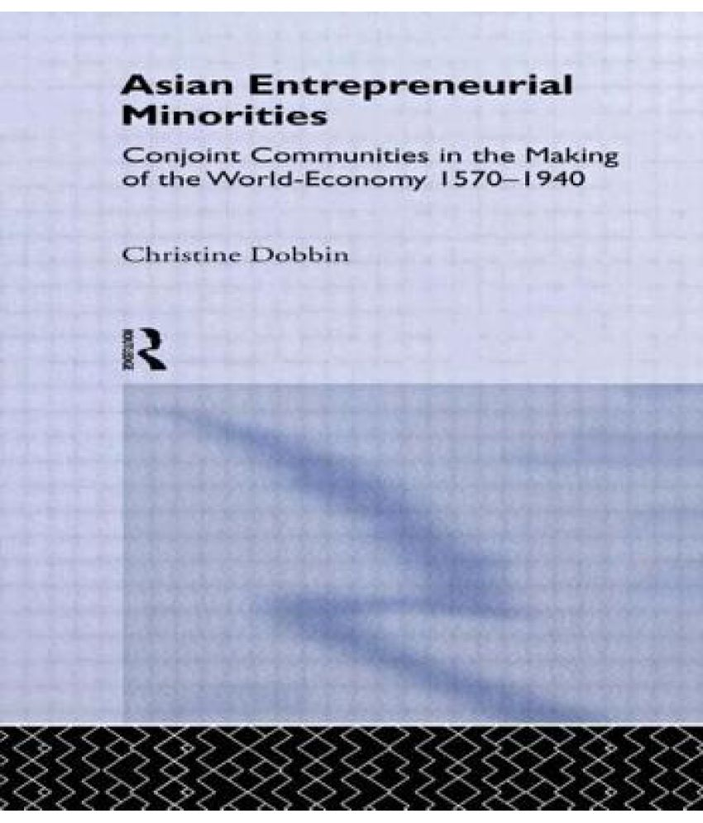
Mercantile Communities and the Making of the World Economy
Role of trade diasporas in the world economy
  Hokkien Chinese in Java and Phillinies
  Chinese mestizos in Philippines
  Parsis in Bombay
  Straits Chinese in Singapore
  Chettiars and Arabs in Singapore
Traders, moneylenders, bankers, tax farmers, landowners
Reasons for entrepreneurial success
  thrived under the aegis of colonial powers

Slide 4
Why did these communities thrive in trade and under colonial powers?
Religion/ Culture as a source of Economic Creativity
The advantage of being ‘Stranger’ communities
Experienced in Trade
Forged special links with colonial authorities
  Re-adjusted commercial ties
  Recast social customs to respond to new opportunities
Role of Diaspora’s Networks
  Enhanced trust levels
  Created conduits for information and resources among its members
  Reduced barriers to trade over long distances

Slide 5
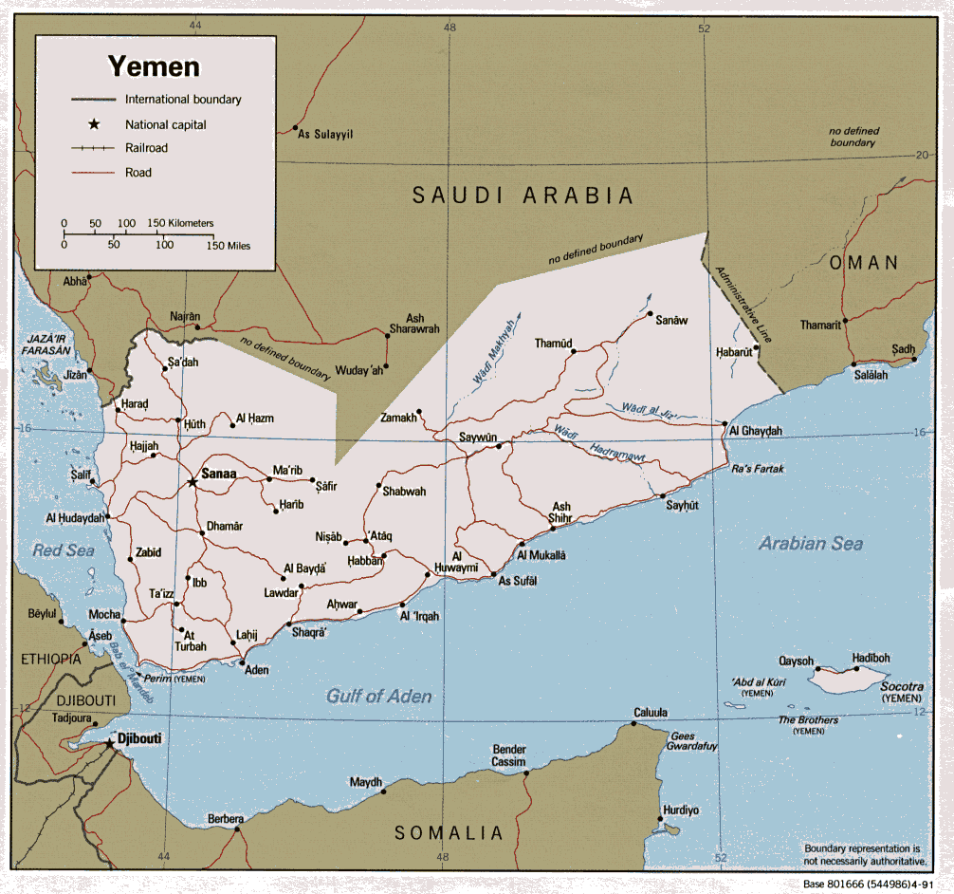
Hadrami Diaspora: an introduction
Arabs in Southeast Asia
  Pre-Islam incense trade
  11th cen
  15th cen: Arabs in high positions
  ‘Scholars, Mystics and Merchants’
Migration: reasons and routes

Slide 6
Distribution and Size of Hadrami Diaspora, 1930s
Netherlands Indies | 71, 335
Singapore | 2,591
Straits Settlement | 2,000
Hyderabad | 13,000
Malabar | 7,000
Africa | 12,717
Egypt/Sudan | 1,200
Saudi Arabia | 12,717
Source; Freitag, Indian Ocean Migrants and state formation in Hadramaut (2003), p. 52

Slide 7
Arab traders in Singapore
1824 | 15
1860 | 115
1871 | 465
1921 | 1282
1936 | Alien Ordinance
1947 | 2591
1957 | 3471
1980 | 2491 (0.1% census)

Slide 8
Economic Activities & Niches (I)
Wholesale Trade
Commodity specialization
Shipping
    Inter-island
    Bulk shipping
    Intermediaries
    Challenges of steam
    Cartelization, 1930s
Interests in Pilgrim traffic

Slide 9
Economic Activities & Niches(II)
Real Estate
  1885: 25% of Singapore real estate
  Interest in property extends to Arabs in Indonesia/ Arabs in India
  Handling agents for property: (Alsagoff & Co; Alkaff & Co)
  Interest in hotels
Finance
  Money lending
Press interests
Manufacturing & Primary Production

Slide 10
Estimate of Arab commercial firms, with capital of over 10,000 guilders, 1885
Location | Number of firms | Percentage of firms
Singapore | 80 | 29.0%
Surabaya | 43 | 15.6%
Palenbang | 37 | 13.4%
Batavia | 22 | 8.0%
Pekalongan | 18 | 6.5%
Semarang | 14 | 5.1%
Sumenep | 12 | 4.3%
Others | 50 | 18.1%
Total | 276 | 100%

Slide 11
Estimated value of Arab investment in real estate, 1885
Town | Millions of guilders | Per cent of total
Singapore | 4 | 25.0%
Surabaya | 3 | 18.8%
Batavia | 2.5 | 15.6
Pontianak | 2 | 12.5%
Semarang | 1 | 6.3%
Penang & rest of Malaya | 1 | 6.3%
Source: William G Clarence Smith, in Freitag and Smith (ed)

Slide 12
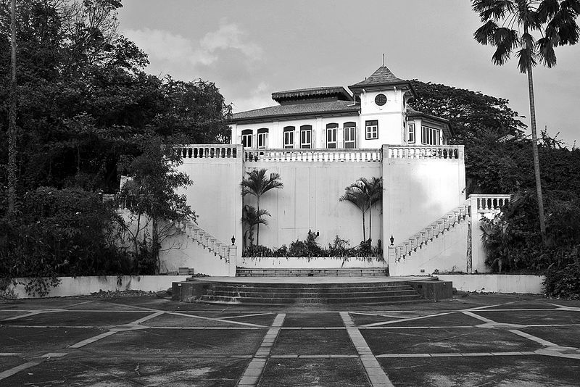
Case Studies
Alkaff
Shayah ibn Abd-al-Rahman
Migration route (India-Surabaya)
Economic interests
  spices, cloth
Increasing interests in real estate (1888)
Connections with Hadramaut
Al Junayd Family: Muhammad ibn Harun al Junayd
Migration Route: India – Palembang
Trading interests
  Cloth trade and real estate; shipping
Networks with Hadramaut

Slide 13
Hadrami ‘Golden Age’
Progression from minimal investment in land to trade to real estate
Position in colonial rule
  Consul Generals, JPs
Contributions to reform in Hadramaut
Connections with local and regional elite
Philanthropic portfolios

Slide 14
Changing Fortunes: Economic Eclipse (I)
Immediate causes
Impact of cartelization by British & Dutch lines
Impact of Japanese occupation
1947 Impact of Rent control Act (pre-war buildings)
  Relocation of assets to Aden
1966 Impact of Land Acquisition Act
  Taking over of land by the state at expiry of land leases

Slide 15
Changing Fortunes (II): ‘Crisis in capitalist development’
Flaws in organisation: Nature of individual firms
‘Fractured financial development’
Absence of hinterland support
Role of Remittances
Nature of Arab commercial infrastructure
Spatial spread
Weak Networks?

Slide 16
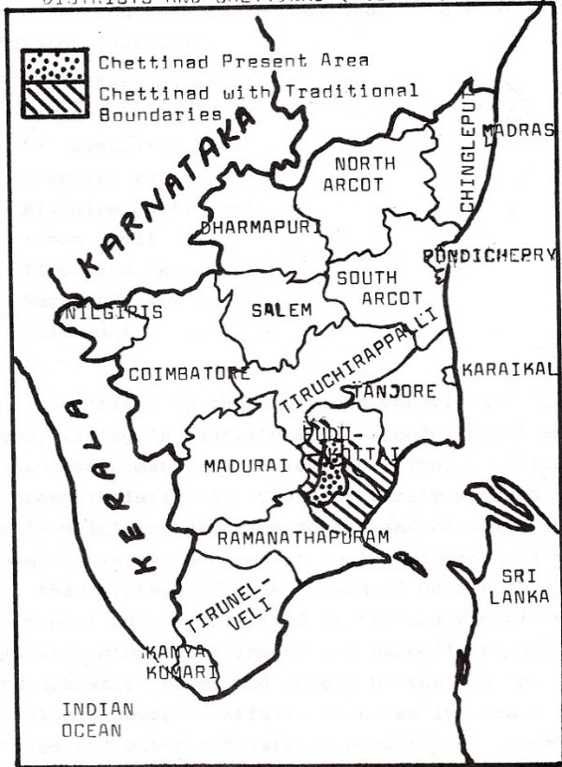
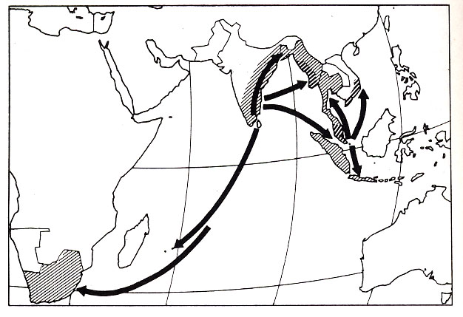
Case Study II: Nattukottai Chettairs
9 subdivisions or clans; 9 villages
Reasons for Migration
Settlements:
Malaya
  Malacca 1808
  Penang 1828 & Singapore 1840s
Burma : Rangoon
    1839: 19 Indians in Rangoon; 1881: 65,000; 1891:Outnumberd Burmese
South Vietnam, 1925

Slide 17
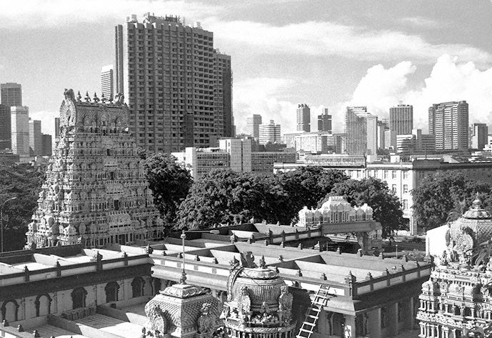
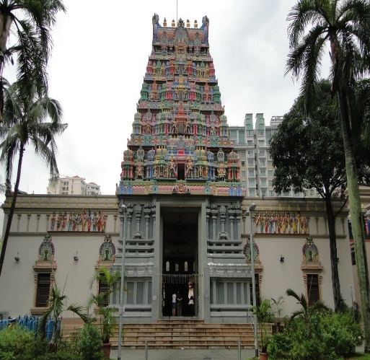
Chettiars Economic Niches & Social Organisation
Economic Niches in Singapore
Independent Investment in Rubber and Tin
  1930: 242 rubber estates
Economic Depression of 1930s and the Fortunes of the Chettiars
Chettiar Temple in Singapore: Economic Role

Slide 18
Thank You
Part II

